Slide 1

CLOUD-BASED AGENTIC SOLUTION
Powering Intelligent Agents with Cloud Technology
Miminions.ai is working on building a modern cloud setup to run powerful, intelligent agents that can handle a variety of tasks. These agents can be more:
Scalable
Secure
Efficient
Flexible
MIMINIONS.AI
COURSE CODE – CLCM3998
(Yelp Image, n.d.)

Slide 2

Problem Statements
Build and deploy a cloud-based AI agent that processes user content, scales efficiently, and follows governance and compliance rules.
Why it matters?
To stay competitive, organizations must embrace intelligent, automated infrastructure.
Our Project Objectives
To build a cloud-based RAG system that can grow with user demand and Cloud Architecture solution.
(Squarespace, n.d.)

Slide 3




Team Members
Taral Kotwal
Sandeep Parwal
Geetha Narasimha
Aditya Mhatre
UI/UX Manager
t.kotwal365@mybvc.ca
472365
Cloud Engineer
Product Manager
s.parwal175@mybvc.ca
463175
Cloud Specialist
Cloud Manager
g.narasimha064@mybvc.ca
463064
Cloud Specialist
Marketing Manager
a.mhatre623@mybvc.ca
472623
Cloud Engineer

Slide 4

Technology Stack
Infrastructure as Code | Terraform
Application Layer | Python - Flask | Postman
Cloud | AWS Services
DevOps and Deployment | Jenkins | GitHub | Docker
(Freepik, n.d.)​

Slide 5
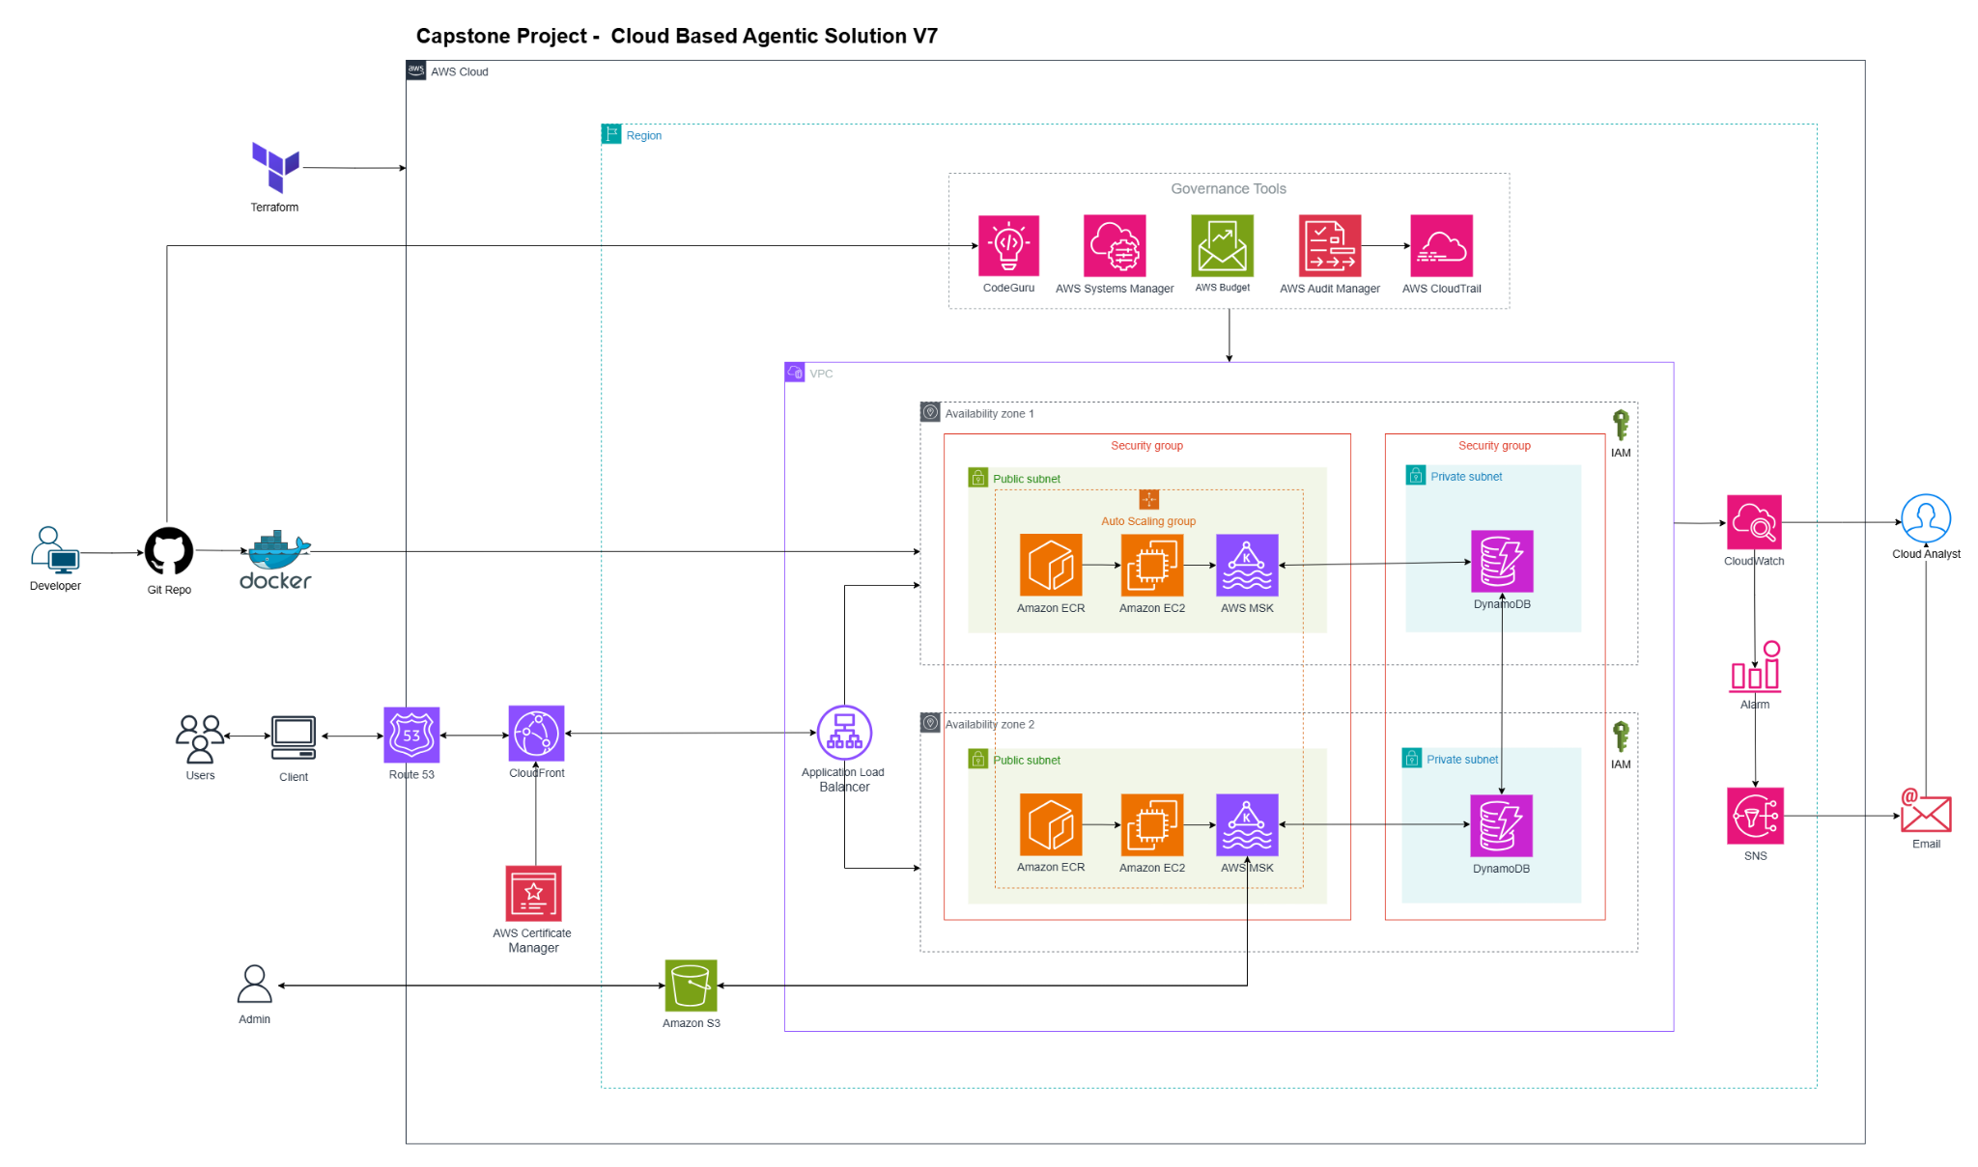

AWS Architecture Diagram

Slide 6
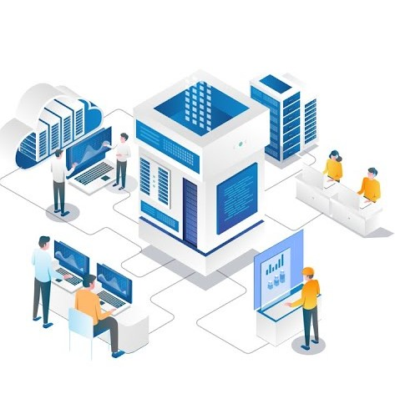
Governance Compliance
• Compliance Requirements
e.g. GDPR
• Security Protocols
e.g., IAM
• Cost Management and Optimization
e.g., AWS Budget
• Monitoring and Auditing Mechanism
e.g., AWS CloudWatch, AWS CloudTrail
• Policy-as-Code for Automated Enforcement
e.g., AWS Config
(Cloud Tech Services, 2022)​

Slide 7
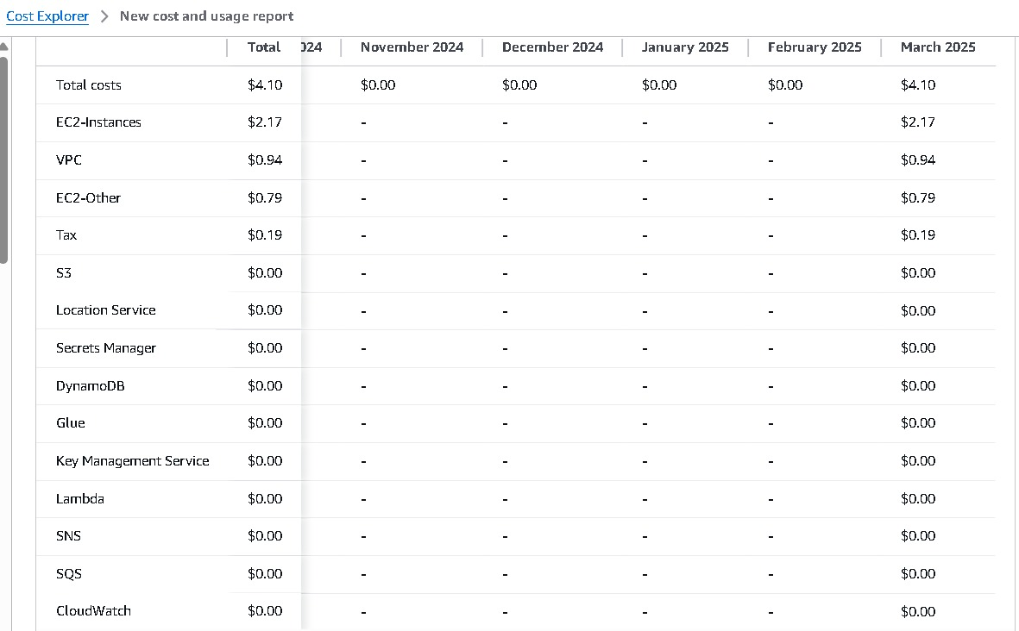
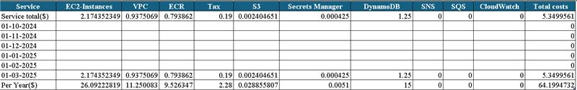
Cost Analysis

Slide 8
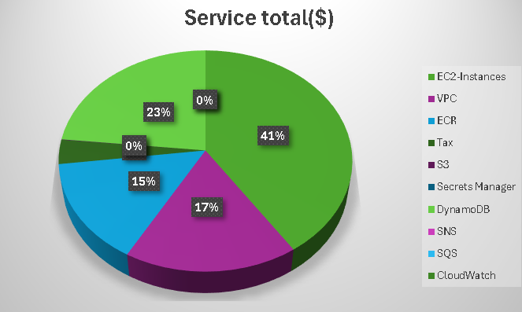
Cost Analysis

Slide 9
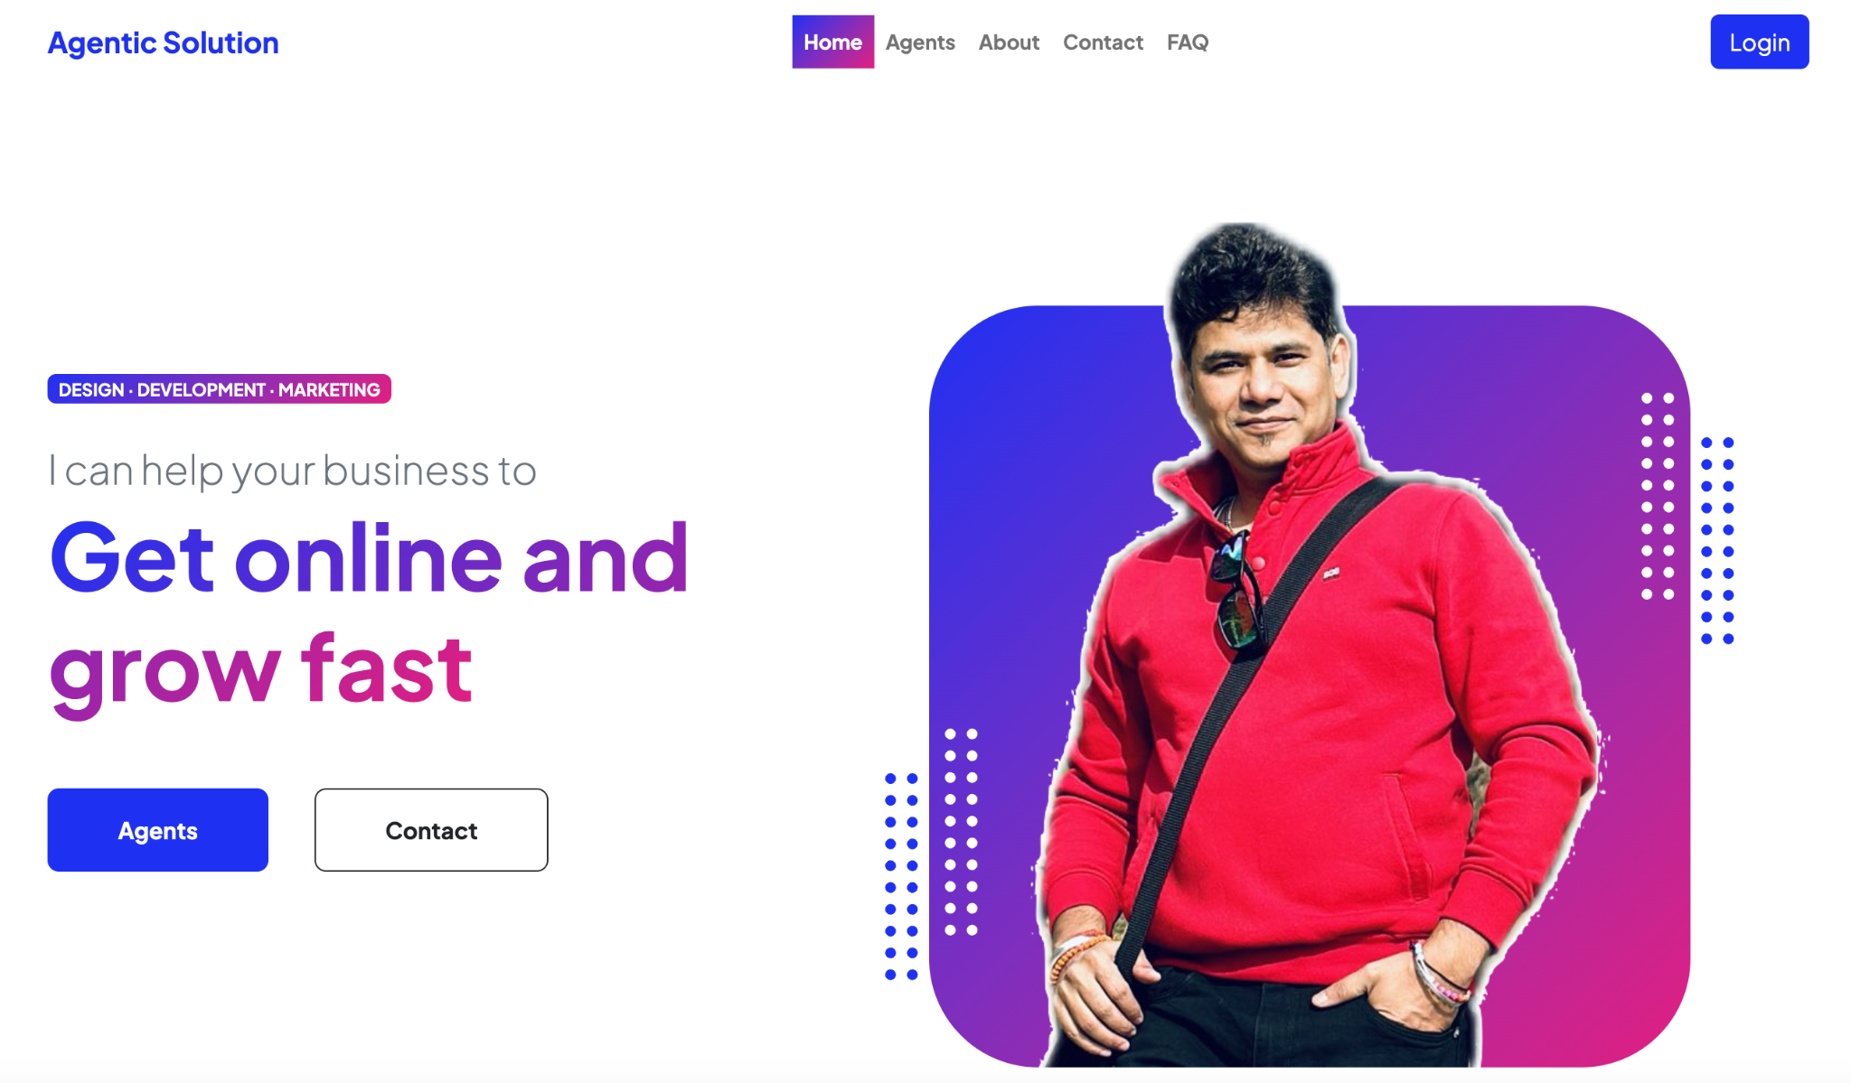
Retrieval Augmented Generation Applications (RAG)
RAG: Combines retrieval-based and generative AI models. It fetches relevant documents to generate fact-based responses.
Retrieval: The system retrieves relevant information from a knowledge base (e.g., documents, databases).
Augmentation: The LLM uses the retrieved information to generate a more informed and accurate response.
Used in applications like chatbots, search engines, and knowledge assistants.

Slide 10
System Architecture
Data
Divided the data
into
Smaller Parts
User Prompt
+
Context
LLM
e.g. OpenAI
Output
Key Benefits
Use Case
Improved Accuracy and Relevance
Real-Time Information Retrieval
Cost Efficiency
Trust & Secure
Customer Support Chatbot
Legal and healthcare document summarization
HR Policies Based Information

Slide 11
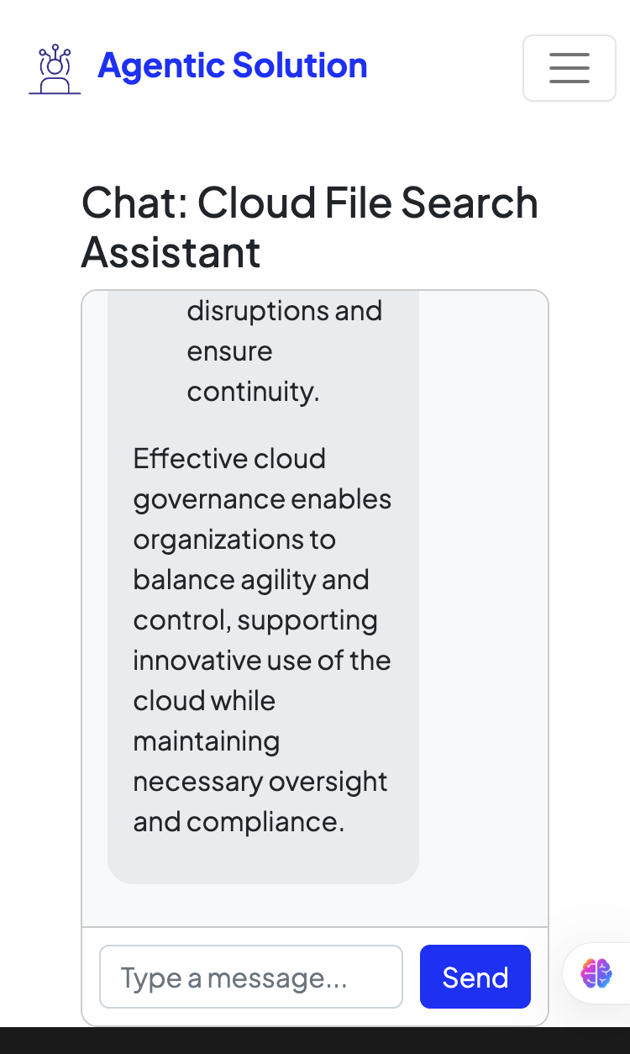
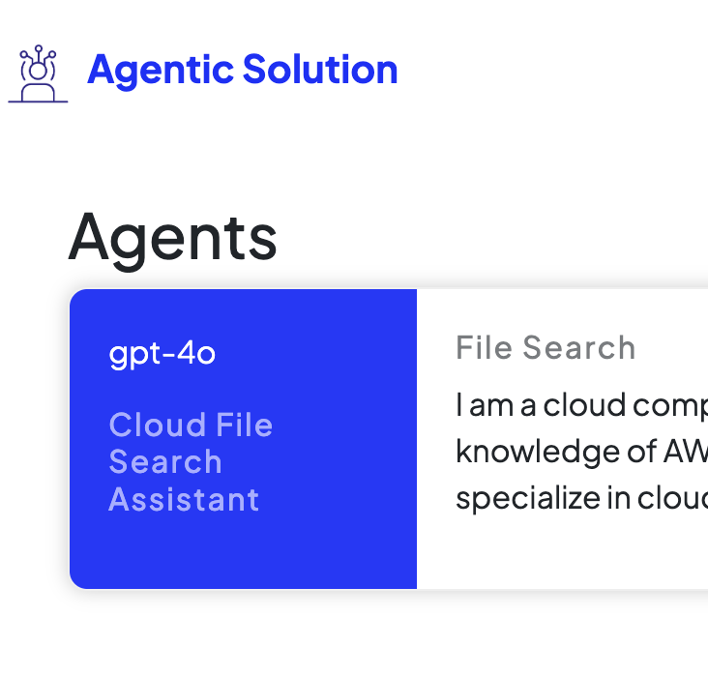

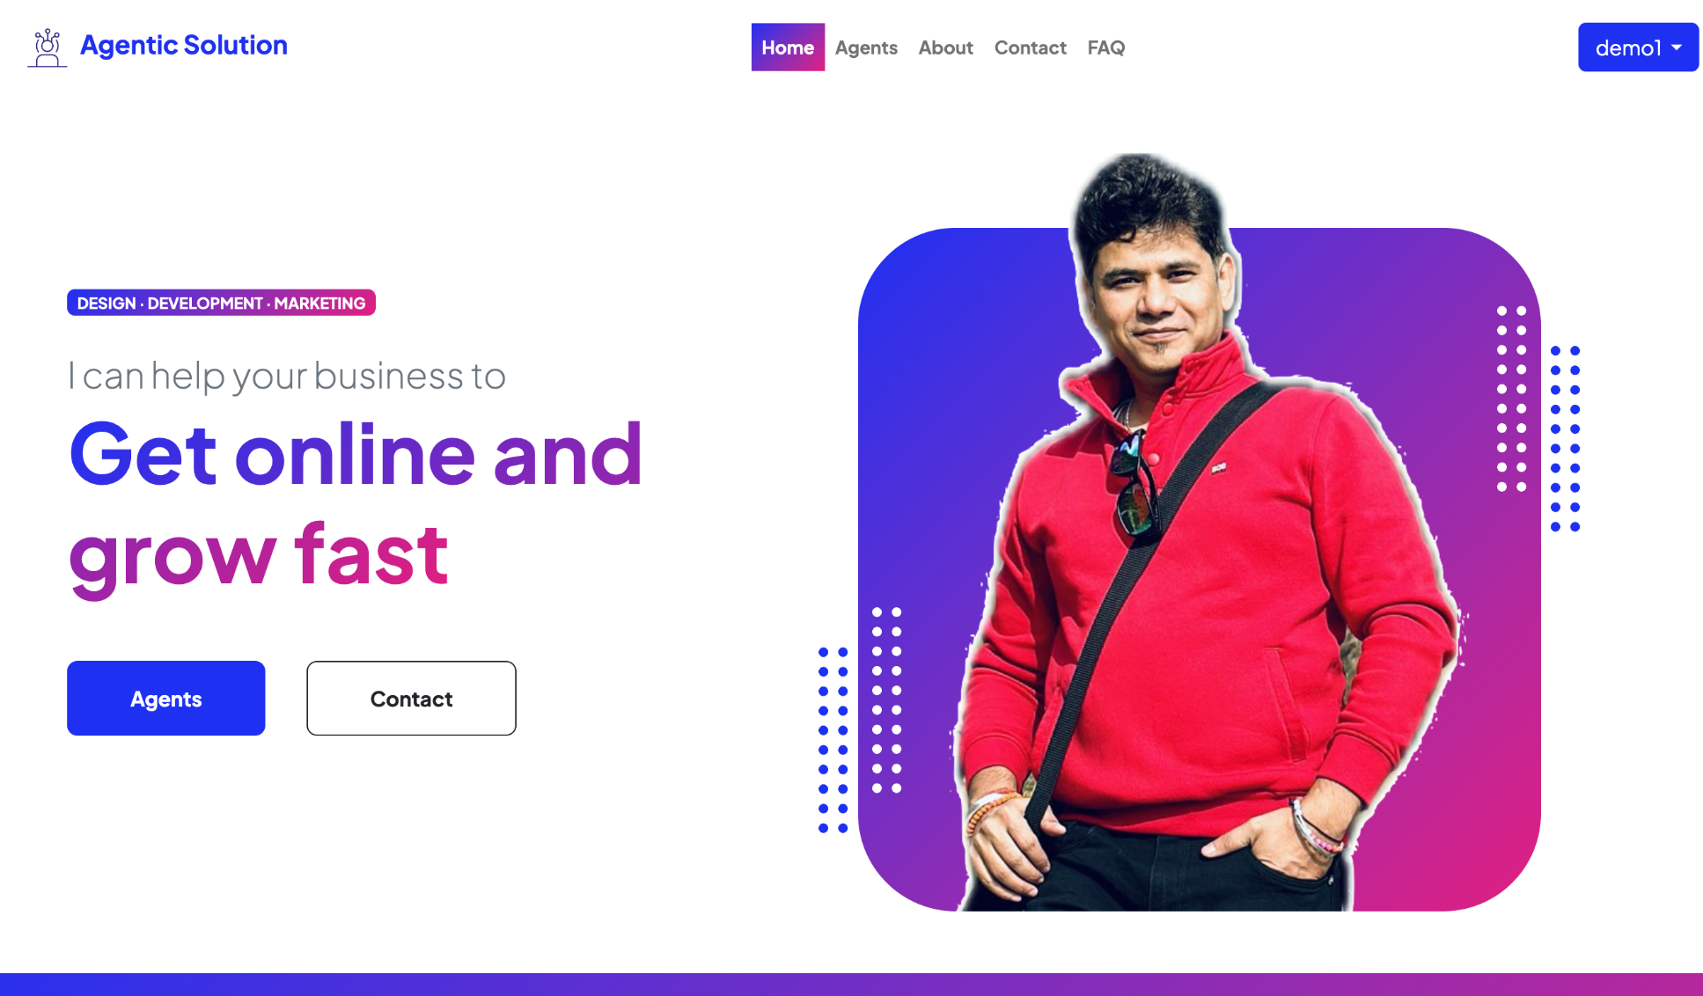

Demo – Agentic Solution Application
Home Page
Customized Agents

Slide 12
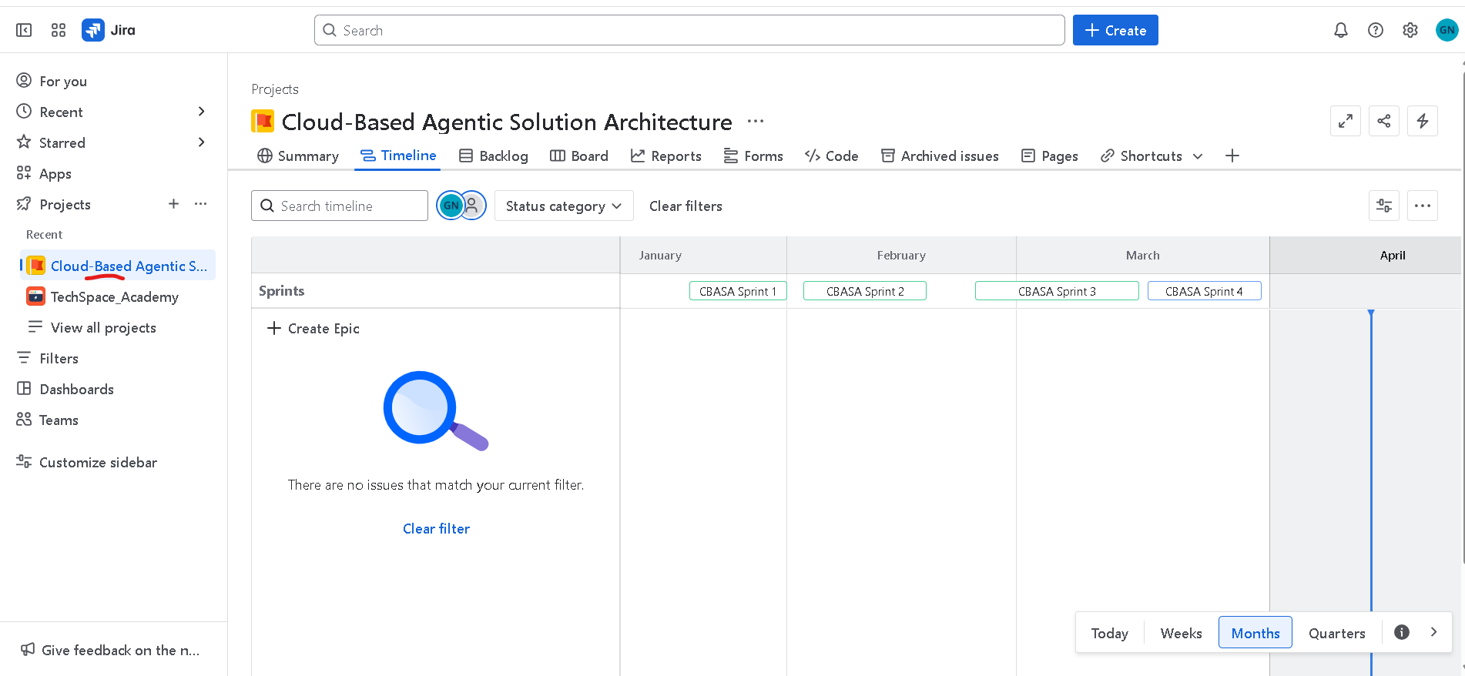
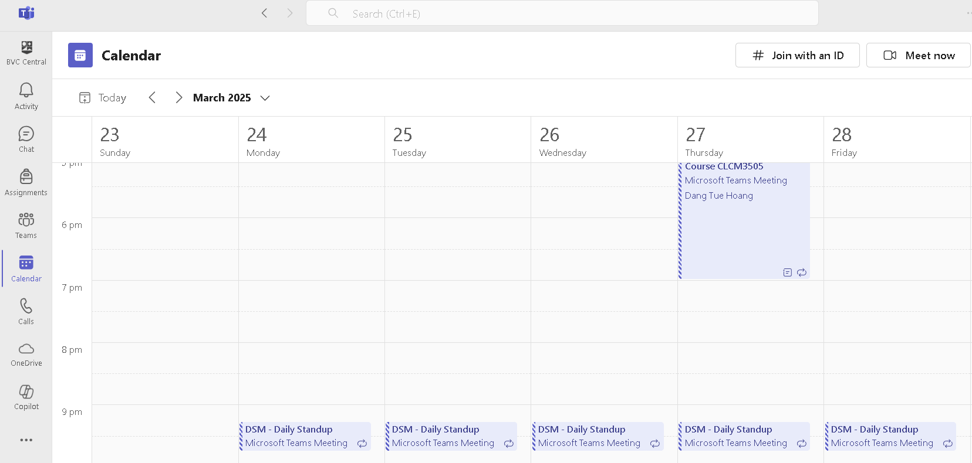
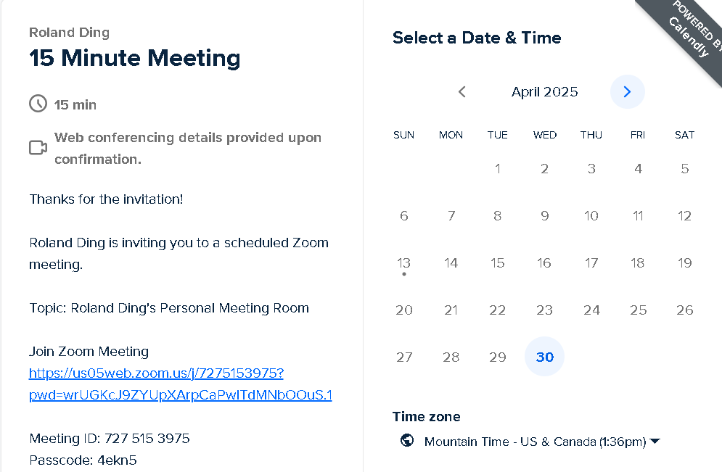
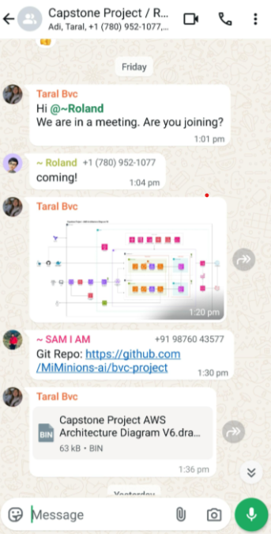
Team/Project Management
JIRA
MS Teams
Calendly/Zoom
WhatsApp

Slide 13



Benefits of AI Agentic Solutions + Cloud
AI Agents + Cloud: Industry Benefits
Real-time document intelligence, aligning with the industry trend of using AI for personalized knowledge retrieval
AI Agents overcoming Cloud Limitations
Quickly analyze and extract limitations, best practices, and configuration guidelines from complex cloud documentation
AI Agents on Governance
Auditors or compliance teams can query for specific clauses (e.g., "GDPR data retention policy") and get immediate answers.

Slide 14

Limitations
Recommendations
Admin Centric: The system restricts PDF uploads to admins.
Event-driven Processing: Lambda function.
Use tools like Kafka(MSK) to enable real-time processing and autonomous task triggering.
Integrate SageMaker Pipelines for continuous training, testing, and deployment of AI models.
Enable Cross-Cloud Communication to operate across multi-cloud platforms (e.g., AWS, Azure, GCP).
(Medium, n.d.)​

Slide 15



Real World Examples
Doordash Delivery support chat to resolve complaints
Bell Enhances Management process to keep up-to-date policies
Conclusion
The AI-powered, cloud-integrated application effectively streamlines information retrieval from documents, offering users quick, accurate access to specific content. This enhances productivity and supports decision-making while aligning with modern governance and compliance needs.
Learning platform to construct Knowledge graph
‹#›

Slide 16

We extend our heartfelt gratitude to
Our Instructors and Client
For the valuable knowledge, continuous support, and guidance throughout this journey.
Your encouragement and insights were key to helping us turn ideas into impactful solutions.
(Nesterenko Ruslan, n.d.)

Slide 17

Thanks
Q & A
(Yelp Image, n.d.)

